Slide 1
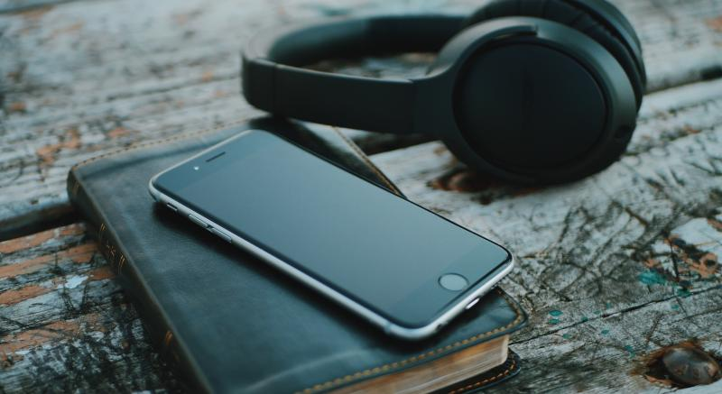
AUDIOBOOK NARRATION USING ARTIFICIAL INTELLIGENCE FOR VISUALLY IMPAIRED PEOPLE
Guided by, Presented by,
Ms.V.T.A . Anitha, M.Tech., Eklklesia UginBS(910318104002)
Assistant professor, Neela Maheswari V(910318104015)
Department of Computer science Engineering, Priyadharshini G(910318104017)
Chendhuran College of Engineering and Technology . Vanmathi S(910318104021)

Slide 2
ABSTRACT
Our work will provide them a Audiobook Narrator of their choice of English language for any e-book in English script.
The plain text from the e-book is fed into the Text to Speech convertor which will generate the audio output file in English.
Audiobook Narrator is usefull for Visually Impaired People. There can easily read the book using a Audiobook Narrator.

Slide 3
OBJECTIVE
Audiobooks allow visually impaired to hear explicit sounds of letters and letter patterns that form words.
Audiobooks also help visually impaired students engage in text and gain exposure to more words, ultimately improving vocabulary, comprehension and critical thinking skills.

Slide 4
INTRODUCTION
Audiobook narrator is the process of Text to Speech technology.
Text to speech technology is the process where in the computer is made to speak. It uses the concepts of natural language processing.
Accessing text documents is troublesome for visually impaired people in many scenarios, such as reading text on the go and accessing text in less than ideal conditions.
Visually impaired people need some portable assistance to read this printed text. So the Audiobook narrator can be used.

Slide 5
TEXT -TO - SPEECH (TTS) CONVERTOR
Text-to-speech (TTS) is a type of assistive technology that reads digital text aloud. It's sometimes called “read aloud” technology.
The voice in TTS is computer-generated Voice quality varies, but some voices sound human.
The text-to-speech (TTS) synthesis procedure consists of two main phases.
The first is text analysis, where the input text is transcribed into a phonetic or some other linguistic representation, and the second one is the generation of speech waveforms, where the output is produced from this phonetic and prosodic information

Slide 6
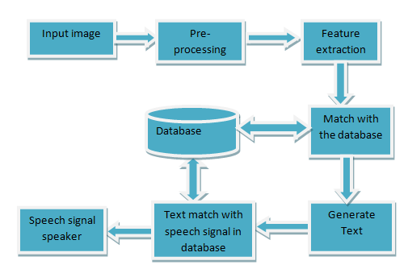
AUDIOBOOK NARRATOR ARCHITECTURE

Slide 7
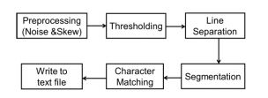
OPTICAL CHARACTER RECOGNITION (OCR)
Optical Character Recognition (OCR) technology is a business solution for automating data extraction from printed or written text from a scanned document or image file and then converting the text into a machine-readable form to be used for data processing like reading the audiobook.

Slide 8
PROPOSED SYSTEM
Our proposed system is used to read the e-book in English language.
Our system use Text-to-Speech(TTS) convertor to convert the text in book.
Our system use Optical Character Recognition(ORC) to extract the data from the image.
Our system will also control the speed of speaker. It will also narrate in different voices.

Slide 9
PROS OF AUDIOBOOK NARRATOR
The system is helpful for persons having learning disabilities or visually challenged.
Prevents eye from strain, and user can sit and listen comfortably.
Saves time especially while driving, exercising and increase the reading speed.
Help improving spelling, reading, writing skills.
Audiobooks is great to avoid the charges associated with the shipping and handling of the braille (or large print) books that really occupy a lot of space and also weight a lot.

Slide 10
CONS OF AUDIOBOOK NARRATOR
They are unable to connect a person with the characters of the books you listen.
It's harder to remember where you heard something and look up references.
It is difficult to follow if distracted from listening.
It is difficult to go back to the content if there was something you didn't understand.

Slide 11
SYSTEM REQUIREMENTS
Hardware Requirements
Processor : Intel processor 3.0GHz
RAM : 4GB
Hard Disk : 500GB

Slide 12
Software Requirements
Front End : Python
Operating System : Windows OS
System type : 32-bit Operating System/64-bit Operating System
IDE : Python 3.9.2

Slide 13
NATURAL LANGUAGE PROCESSING (NLP)
NLP means converting text to the voice speech using NLP. NLP is a field of artificial intelligence that gives the machines the ability to read, understand, and derive meaning from human languages.
It identifies and interprets words and phrases in spoken language and converts them into texts by computers.
NLP is usually deployed for two of the primary tasks namely Speech Recognition and Language Translation.

Slide 14
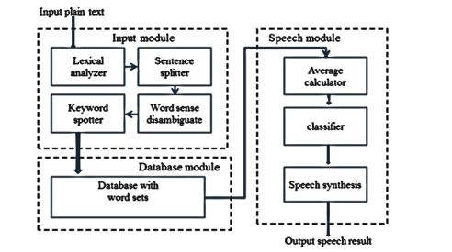
MODULES DIAGRAM

Slide 15
MODULES
Input Module
Database Module
Speech Module

Slide 16
MODULE 1 : INPUT MODULE
The plain text is first get into the Lexical Analyzer then it separate into tokens(smallest individual unit).
The sentences spliter will split the sentences
In natural language processing, Word Sense Disambiguation (WSD) is the problem of determining which "sense" (meaning) of a word is activated by the use of the word in a particular context, then enter into the spotter.

Slide 17
MODULE 2 : DATABASE MODULE
In the database module , it will check with the word in the book presented in the database
This module will check with the e-book in the database.
It will compare the word set.

Slide 18
MODULE 3 : SPEECH MODULE
Speech can be in different voices, we can also control the speed of the speaker.
Speech classification is a means for automatic classification of audio signals. Using these techniques, the incoming speech signals can be classified, sorted and prioritized.
Speech synthesis is the artificial production of human speech. A computer system used for this purpose is called a speech computer or speech synthesizer
Synthesized speech can be created by concatenating pieces of recorded speech that are stored in a database.

Slide 19
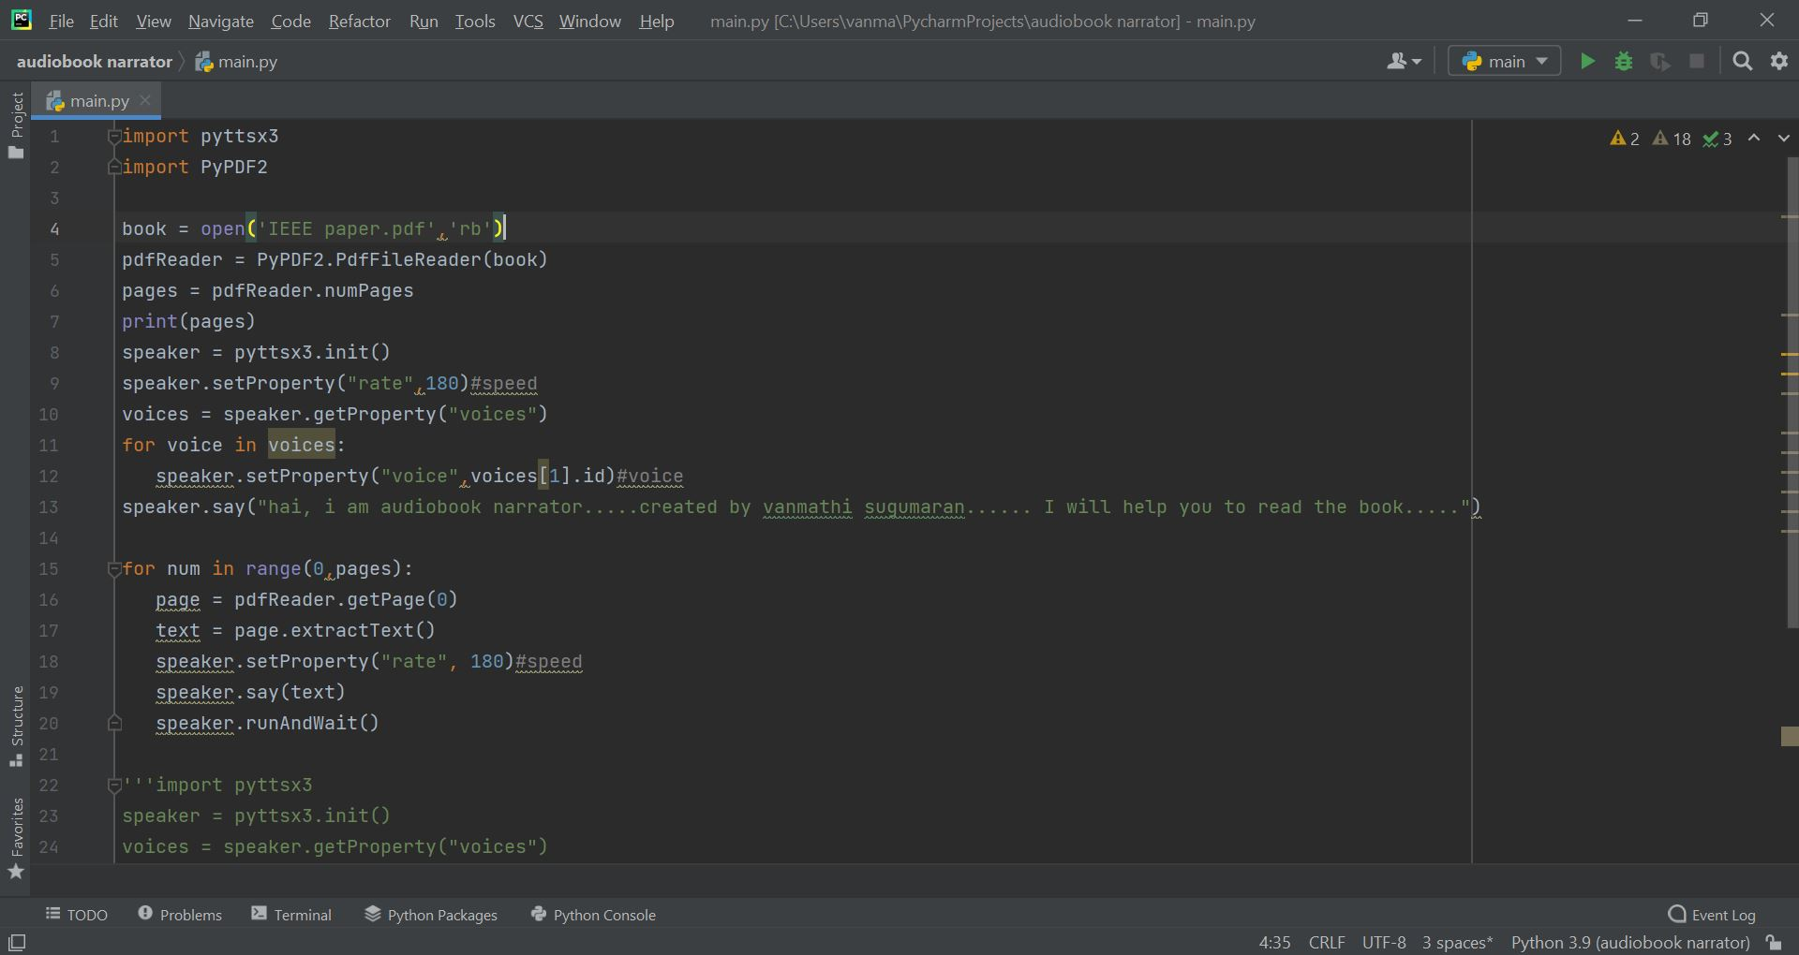
SCREENSHOTS

Slide 20
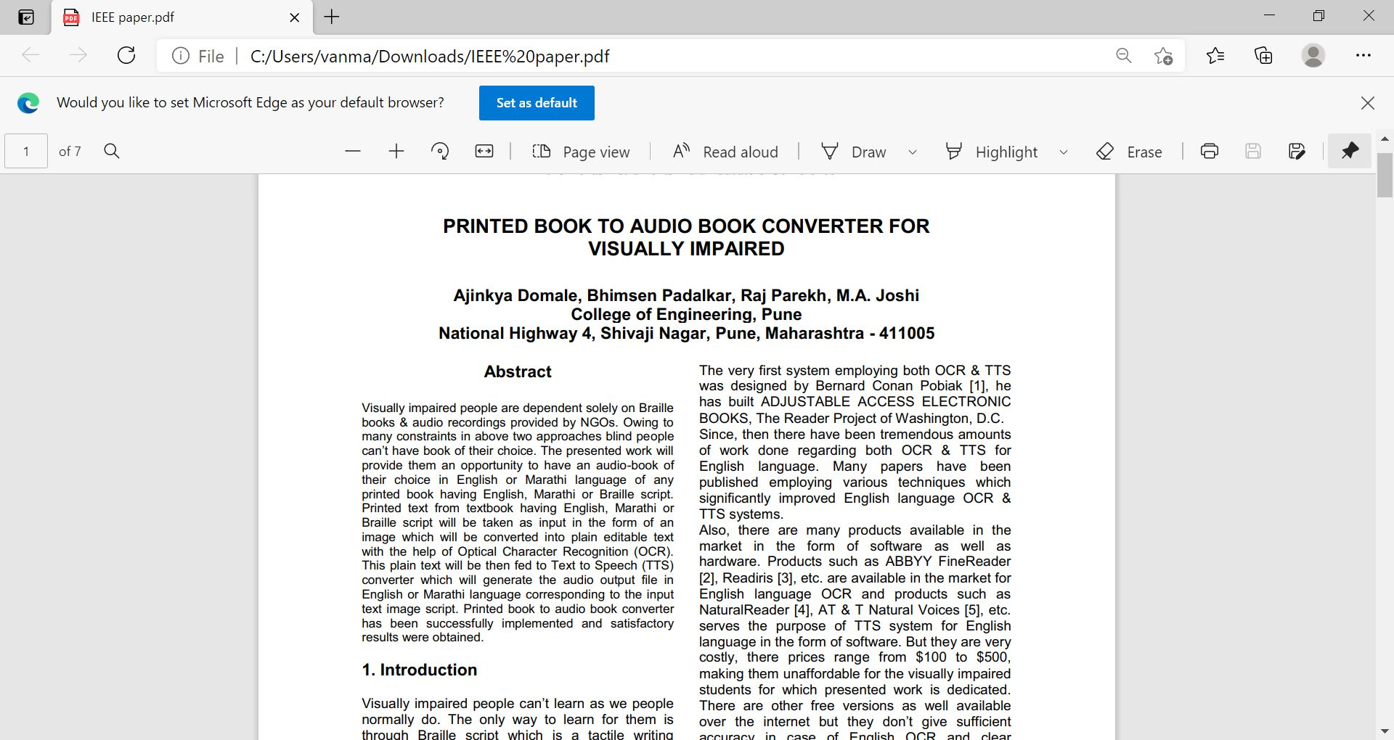
BOOK PAGE

Slide 21
CONCLUSION
The Audiobook Narrator for blind produces a positive outcome when applied in practical world.
In this research work, a Text-to-Speech device for visual impaired people that can change the text image input into sound is implemented.
This system is useful for visually impaired persons to access information which is in the form of documents, texts or printed forms.
The future implementation may include accuracy and fulfil the limitations of existing systems.

Slide 22
FUTURE ENHANCEMENT
The future of this work is to enhance the robustness of system by overcoming the challenges like improve the pronounciation. Furthermore we are planning to work on implementing different kinds of languages.

Slide 23
REFERENCES
[1] R. Dunn, & K. Dunn, Using learning styles data to develop student prescriptions, In J.W. Keefe (ed.), Student learning styles diagnosing and prescribing programs, pp. 109-122, 1979, Reston, VANationalAssociation of Secondary School Principals
[2] World Health Organisation, ICD-11 International Classification of Diseases for Mortality and Morbidity Statistics (Eleventh Revision), 2018,https://icd.who.int/browse11/lm/en#/http%3a%2f%2fid.who.int%2ficd%2fentity%2f1103667651
[3] World Bank, Pivoting to Inclusion: Leveraging Lessons from the COVID-19 Crisis for Learners with Disabilities. Washington DC: International Bank for Reconstruction and Development/The World Bank, 2020, http://pubdocs.worldbank.org
[4] A. That, A short history of the audiobook, 20 years after the first portable digital audio device,Nov22,2017,https://www.pbs.org/newshour/arts/a-shorthistory-of-the-audiobook-20-years-after-the-firstportable-digital-audio-device

Slide 24


